Slide 1



SAKILA
Rent Your Favorite Movie

Slide 2
Overview
This project involves enhancing the Sakila Database, a fictional DVD rental store system. Key tasks included data enrichment, cleansing, and structuring, followed by data modeling and ending with data analysis and visualization.

Slide 3
Objectives and Goals
Why: Enhance the Sakila Database to support advanced data analysis and visualization.
What: Apply data cleansing, modeling, and reporting to build a reliable and scalable database solution.
Business Description: The Sakila Database simulates a DVD rental store, managing inventory, transactions, and rentals.
Why It Matters: Efficient data management is key to optimizing operations, tracking performance, and understanding customer behavior, driving better business outcomes. Additionally, the DVD rental business plays a vital role in bringing people together, offering quality entertainment that fosters family bonding and social connections.

Slide 4
Project Stages
Data Source
Data Understanding and Mapping
Data Enrichment
Data Cleansing and Validation
DWH Design
DWH Implementation (ETL)
Advanced Analytics and Visualization

Slide 5
Data Source
The Sakila database was sourced from MySQL Server as a demo dataset.
The initial dataset covered only months 5, 6, 7, and 8. To create a more comprehensive data sample for analysis, we generated additional data for the remaining months.

Slide 6
2. Data Understanding and Mapping
2.1 Table and Column Identification:
Key Tables: Actor, Address, Category, City, Country, Customer, Film, Film_Actor, Film_Category, Inventory, Language, Payment, Rental, Staff, Store.
Sample Columns: actor_id, first_name, last_name, film_id, title, customer_id, rental_date, inventory_id, store_id.
2.2 Relationship Analysis:
Analyzed the relationships between key entities like customers, rentals, and inventory to understand their interactions within the database

Slide 7
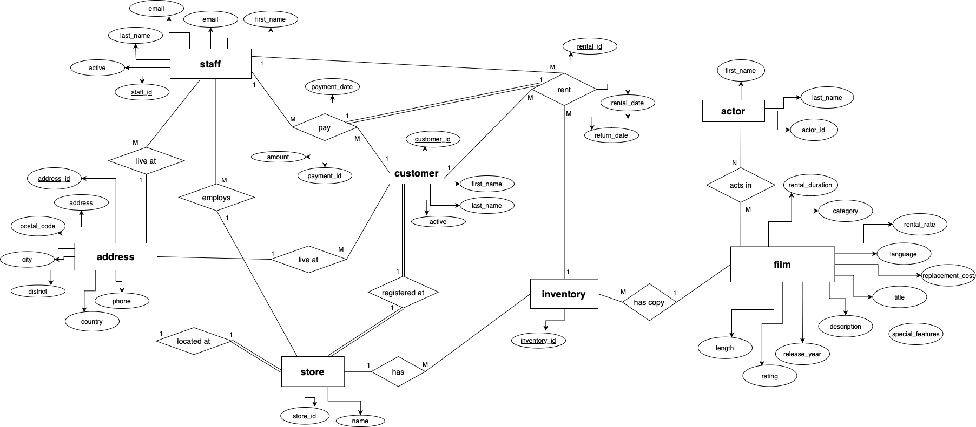
2. Data Understanding and Mapping (Cont.)
2.3 ERD Creation:
Developed an Entity-Relationship Diagram (ERD) to visualize these relationships and ensure a clear understanding of data interconnections.

Slide 8
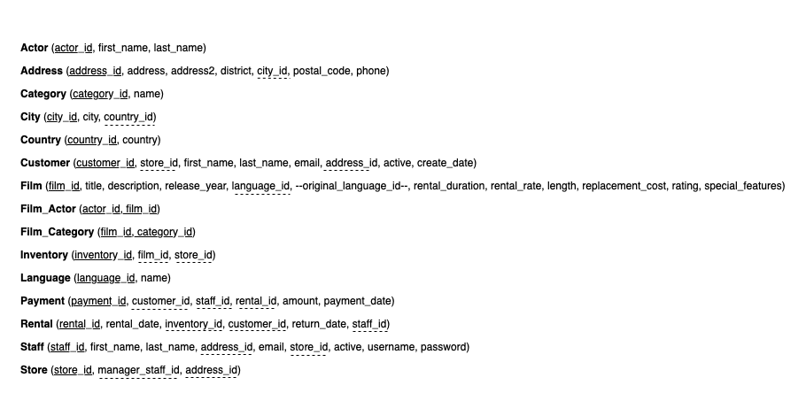
2. Data Understanding and Mapping (Cont.)
2.4 Data Mapping and Normalization:
Mapped the data fields based on the ERD and normalized the data to ensure consistency and prepare for efficient data processing.

Slide 9
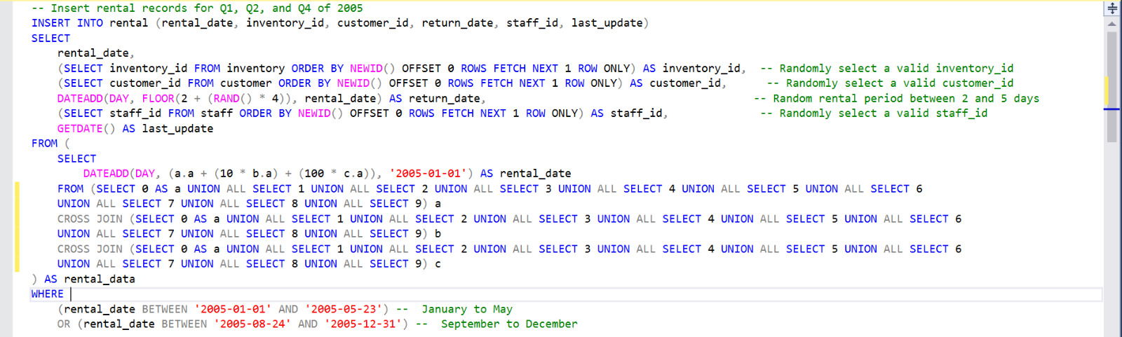
3. Data Enrichment
We utilized SQL to generate random values for the remaining months, ensuring a complete dataset covering the entire year. The Payment and Rental tables were updated with these values, using random foreign key references within their respective ranges. Below is a snapshot of the SQL code used for this process.

Slide 10
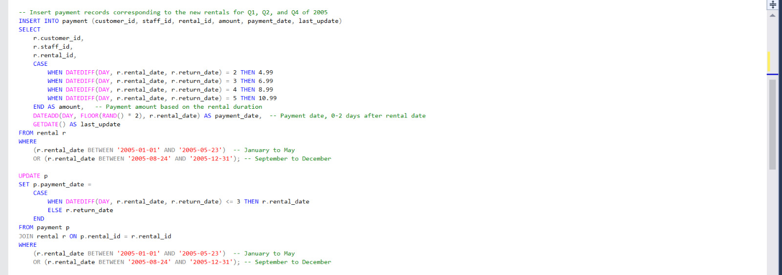
3. Data Enrichment (Cont.)

Slide 11
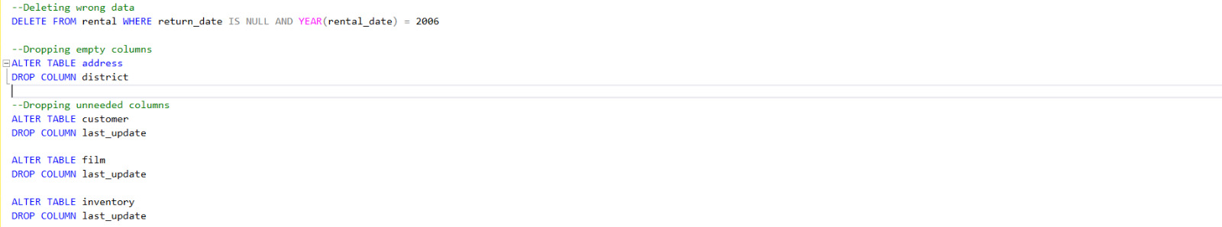
4. Data Cleansing and Validation
In this section, we utilized SQL to identify and handle null values effectively. For instance, the Rental table was intended to contain data exclusively from 2005, yet some entries had rental dates from 2006 and corresponding null return dates. These rows were deleted to maintain data integrity. Additionally, the district column in the Address table was found to be empty, leading to its removal. We also dropped the last_update column from each table as it was not relevant for further analysis. Below is a sample of the SQL code we used.

Slide 12
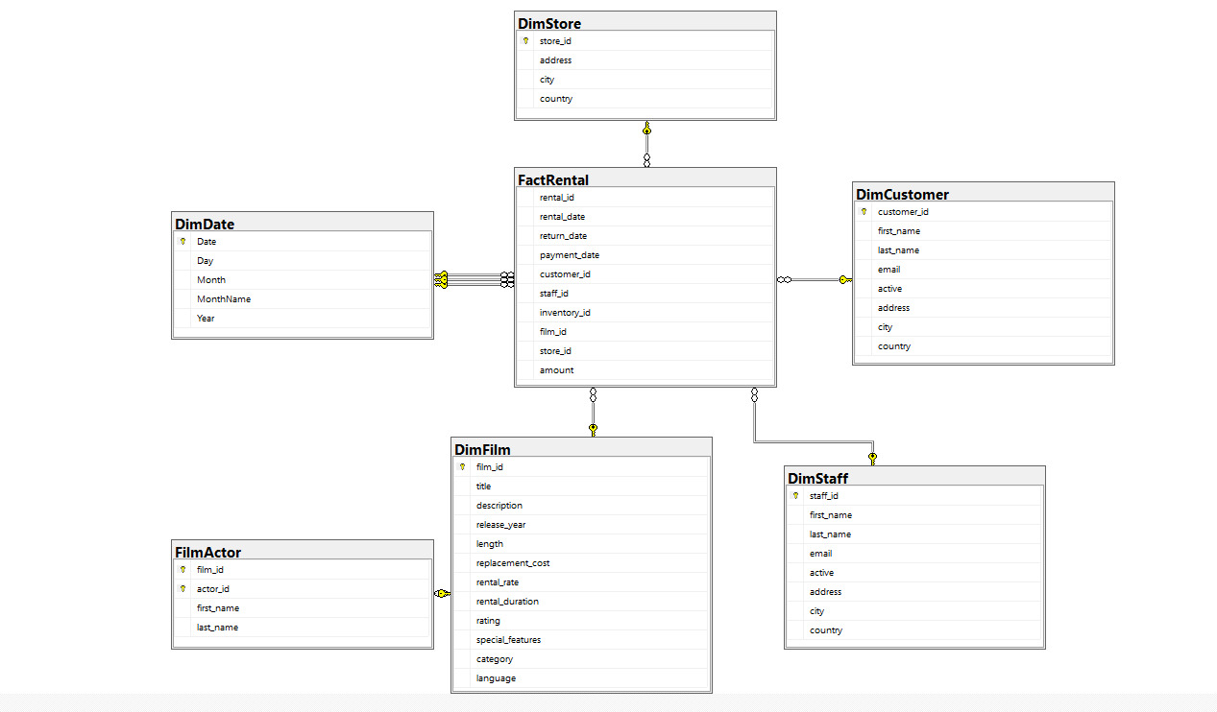
5. Data Warehouse Design
We applied data modeling concepts to develop a snowflake schema for our Data Warehouse.
The main tables included in this schema are FactRental, DimDate, DimCustomer, DimFilm, FilmActor, DimStaff,and DimStore.
This design approach ensures efficient data storage, retrieval, and reporting.
It provides a robust foundation for advanced analytics.

Slide 13
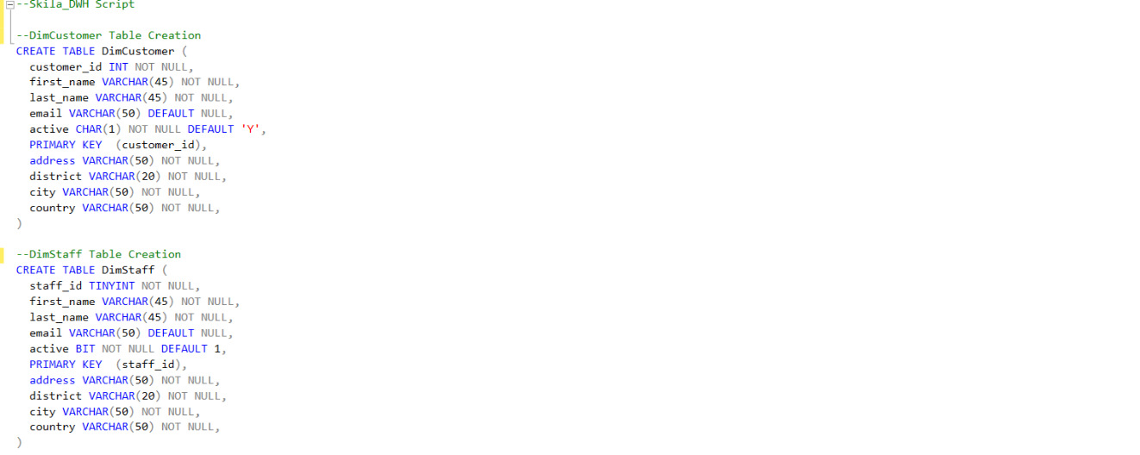
6. Data Warehouse Implementation
In this section, we began by creating an empty dataset in SSMS consisting of the DWH tables from our designed model. We ensured that the data types for each column matched those in the original dataset to prevent errors during the data population process in the subsequent steps. Below is a code sample of the DWH creation.

Slide 14
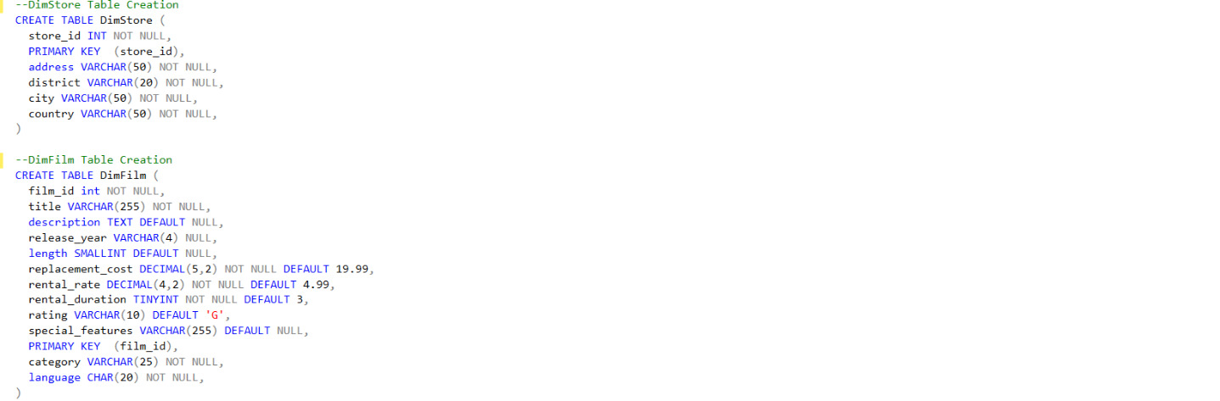
6. Data Warehouse Implementation (Cont.)

Slide 15
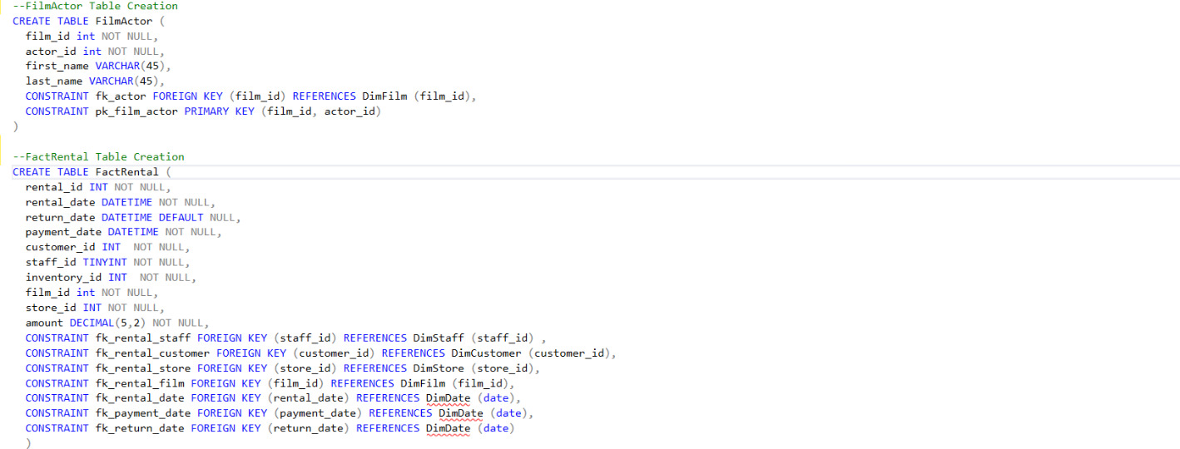
6. Data Warehouse Implementation (Cont.)

Slide 16
6. Data Warehouse Implementation (Cont.)
After creating the empty dataset, we began populating it using the SSIS tool. The process unfolded as follows:
Column Analysis: We reviewed the columns of each empty table in our DWH, comparing them with the original dataset structure. We carefully considered how to align these structures and identified the necessary join statements to ensure that all required values were included without omission.
SQL Validation: We tested the SQL statements on SSMS to ensure they would correctly achieve the desired table structures before implementing them in SSIS.
Data Flow Task Creation: We opened SSIS and created a Data Flow Task for each table in the DWH.
Source and Destination Setup: Within each Data Flow Task, we selected OLE DB Source and Destination components. We ensured that the source data was extracted via SQL commands from the original dataset and that the destination correctly referred to the corresponding empty columns in the DWH.
SQL Command Samples: In the following slides, you will find samples of what’s written as a SQL commands in the OLE DB Source for each table, demonstrating how they were connected to the original database and used to populate the Data Warehouse.

Slide 17
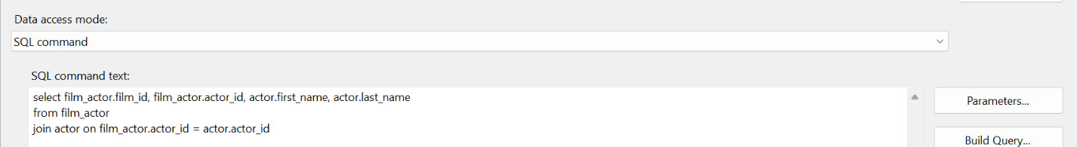
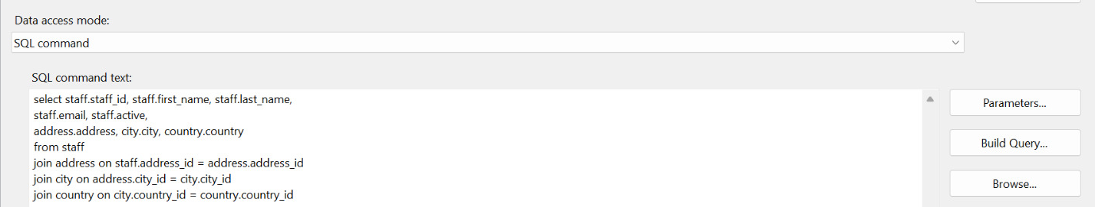
6. Data Warehouse Implementation (Cont.)
FilmActor Table Population:
DimStaff Table Population:

Slide 18
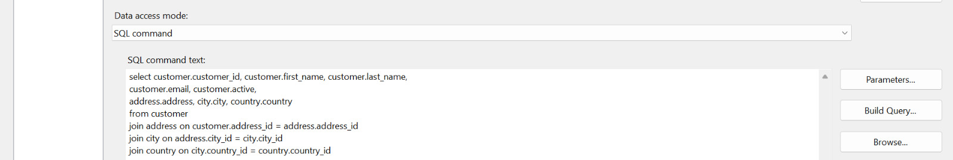
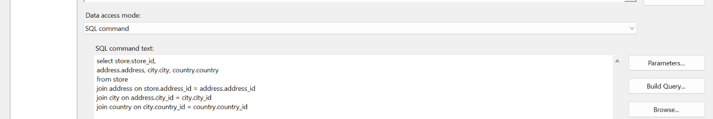
6. Data Warehouse Implementation (Cont.)
DimCustomer Table Population:
DimStore Table Population:

Slide 19
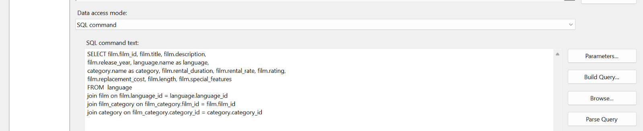
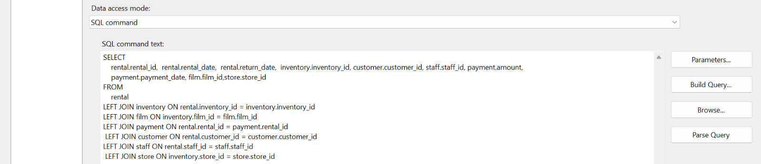
6. Data Warehouse Implementation (Cont.)
DimFilm Table Population:
FactRental Table Population:

Slide 20
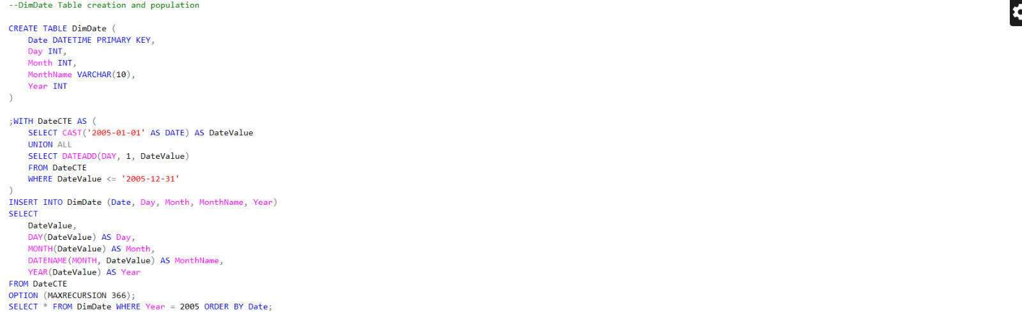
6. Data Warehouse Implementation (Cont.)
For the DimDate table, we needed to create a comprehensive dataset containing all dates for the year 2005. To achieve this, we used SQL code executed directly in SSMS to generate the necessary date entries. Below is a screenshot of the SQL code used for this process.

Slide 21
7. Advanced Analytics and Visualization
In this section, we will discuss how we leveraged multiple analysis and visualization tools to extract and present meaningful business insights. The tools used in this process include:
SSAS
SSRS
Power BI
Tableau
Excel

Slide 22
7.1 Utilizing SQL Server Analysis Service (SSAS)
Analysis using SSAS: during this step Sakila DWH tables were loaded into SQL Server Analysis Services (SSAS).
Cube Design: In this step we design 2 cubes to provide a 360-degree view for the business, allowing to analyze data across multiple dimensions such as customer, location and film.
Creating perspective, that allow to create simplified, focused views of the cube, tailored to specific business needs.

Slide 23
7.1 Utilizing SQL Server Analysis Service (SSAS) (Cont.)
By analyzing the DimFilm and FactRental tables, the business can gain insights into which films are most popular, helping in decision-making around future film acquisitions and marketing efforts.
The amount field in the FactRental table allows the business to analyze revenue across different dimensions such as time, store, and film category. This helps in identifying the most profitable films and stores.
Using the DimCustomer dimension, the business can segment customers based on demographics like location and purchase behavior. This allows for targeted marketing and personalized customer experiences.
With the DimeStore dimension, the business can compare performance across different locations. like total rentals and revenue by store can help identify top-performing stores and areas where improvements are needed.
By understanding the demographics and rental behavior at each store, the business can tailor marketing campaigns to specific regions, improving engagement and sales.
Different perspectives were created to cater to different user needs, such as performance, sales and Customer Analysis.
Creating perspective to limit the visible elements, So users can navigate the cube more efficiently, reducing the time spent searching for the right metrics or dimensions.

Slide 24
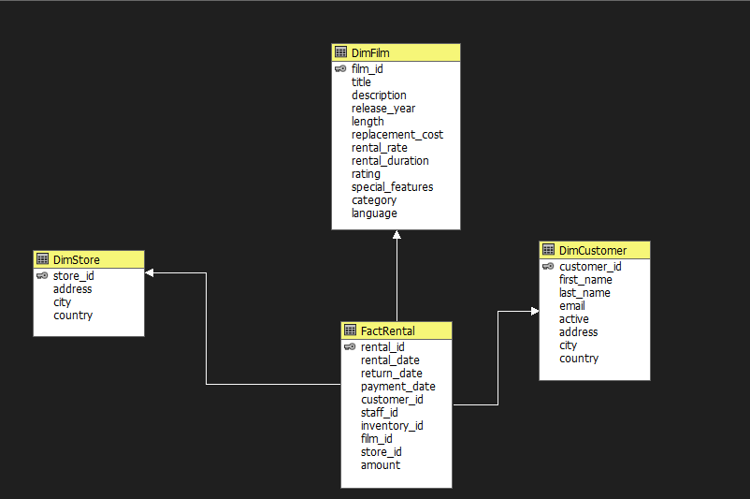
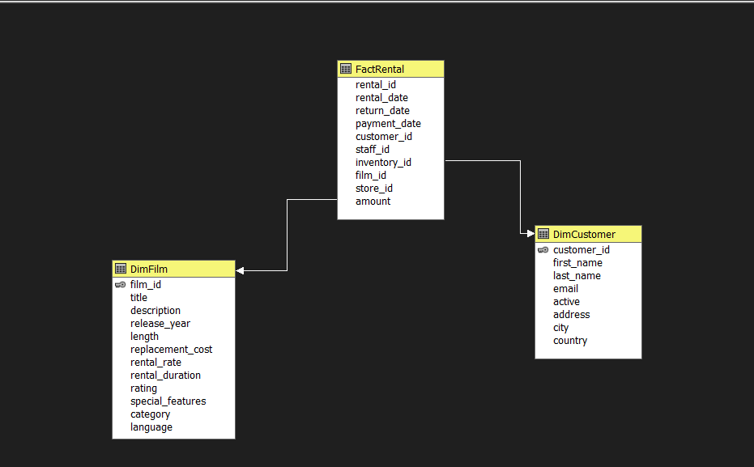
7.1 Utilizing SQL Server Analysis Service (SSAS) (Cont.)
Cubes overview:

Slide 25
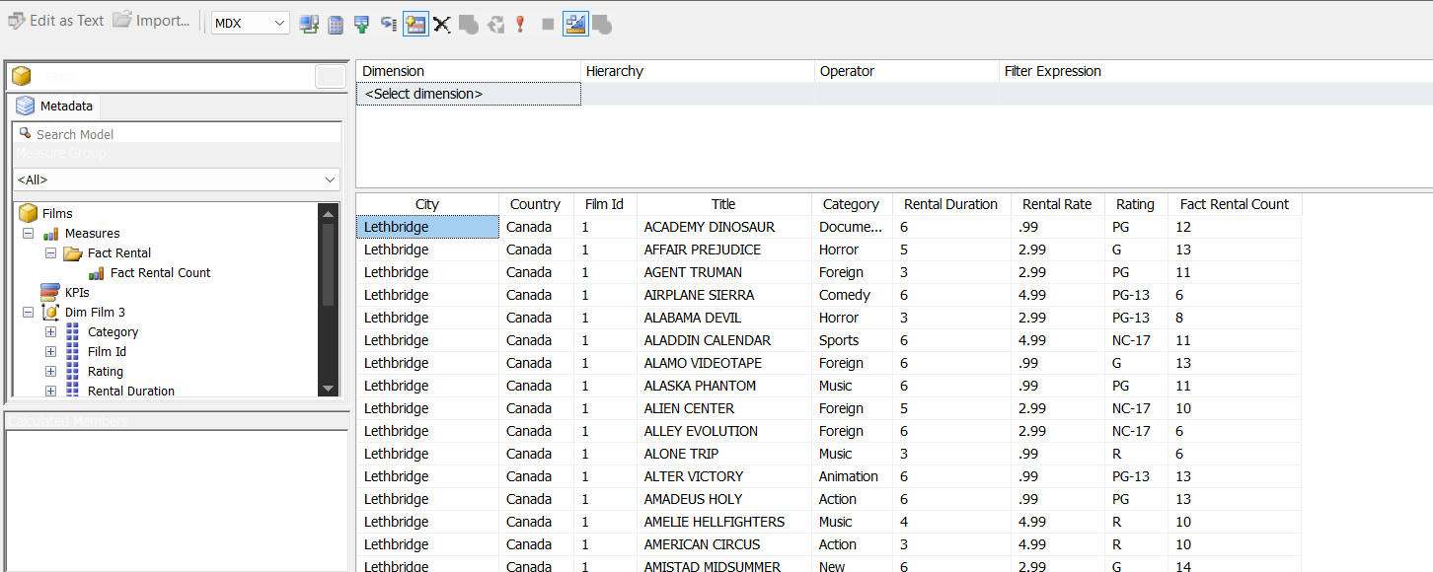
7.1 Utilizing SQL Server Analysis Service (SSAS) (Cont.)
Perspective overview:

Slide 26
7.2 Utilizing SQL Server Reporting Service (SSRS) (Cont.)
Using SSRS , as it can tailored reports that meet specific needs, besides SSRS can handle large volumes of data, making it suitable for businesses of any size.
In our Report we include the following:
Parameters and Filters: allow users to customize the report.
Visualizations: Describe any charts, tables, or other visual elements used to present the data. Explain why these were chosen and how they help in understanding the data.
Drillthrough Action: we used this action to provide more detailed information about a specific data point.

Slide 27
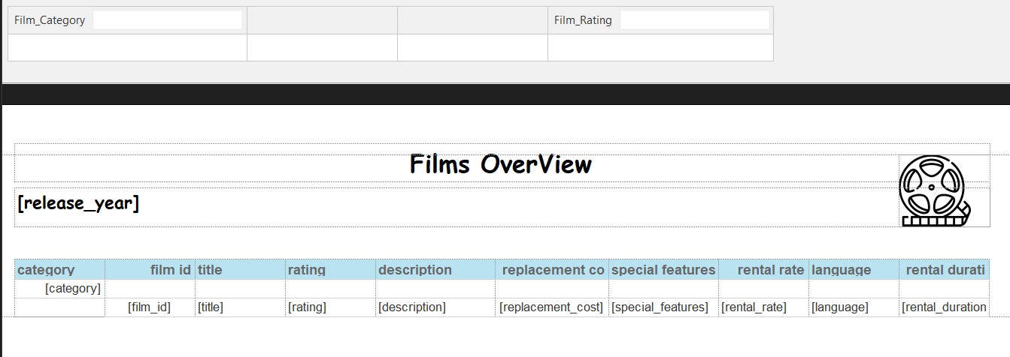
7.2 Utilizing SQL Server Reporting Service (SSRS) (Cont.)
7.2.1 Parameters and filters

Slide 28
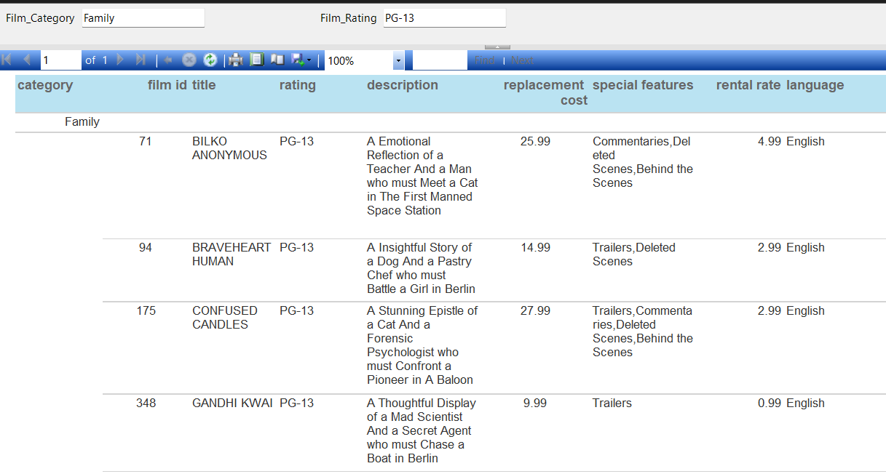
7.2 Utilizing SQL Server Reporting Service (SSRS) (Cont.)
7.2.1 Parameters and filters (cont.)

Slide 29
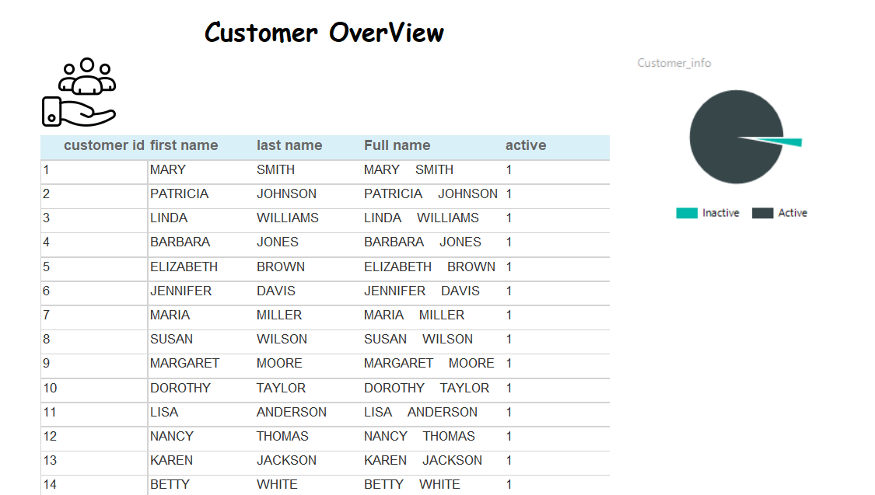
7.2 Utilizing SQL Server Reporting Service (SSRS) (Cont.)
7.2.2 Visualization

Slide 30
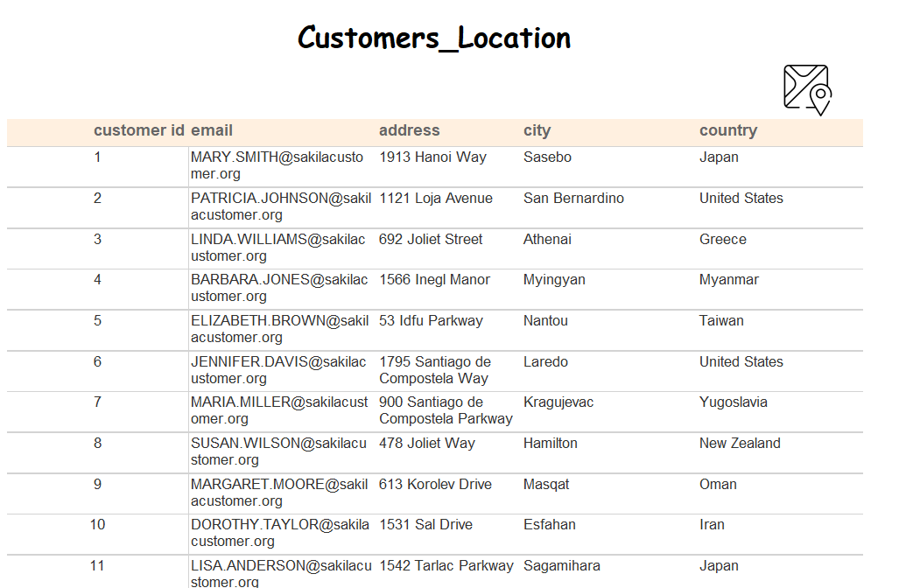
7.2 Utilizing SQL Server Reporting Service (SSRS) (Cont.)
7.2.3 Drillthrough action (cont.)

Slide 31
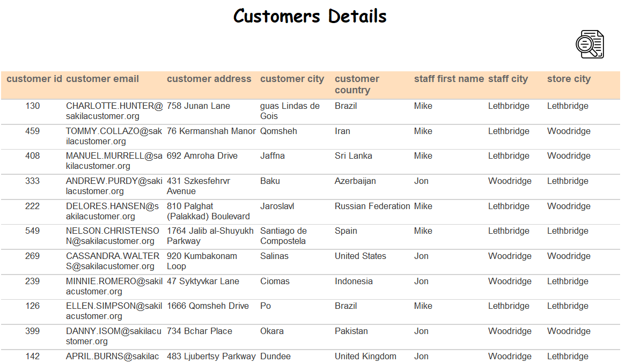
7.2 Utilizing SQL Server Reporting Service (SSRS) (Cont.)
7.2.3 Drillthrough action

Slide 32
7.3 Utilizing PowerBI
In this section, Power BI was used to create interactive dashboards, connecting directly to the DWH to visualize key business metrics. The main dashboard components include:
Home: Overview of key metrics and summaries.
Performance: Detailed analysis of business performance.
Customers: Customer-related metrics and behaviors.
Film: Insights into film inventory, rentals, and trends.
Help: Guidance and resources for using the dashboard and business improvement.

Slide 33
7.3 Utilizing PowerBI (Cont.)
7.3.1 Home Page Visuals Breakdown
Key Metrics: Cards displaying the number of rentals, customers, revenue, and inventory copies.
Charts: Visuals for film categories, top 5 rented movies, rental rates by month, and top 5 customers.
Tooltips: Hovering over each film category reveals movie details, including the number of films and their revenue contribution.
Drill-Throughs: Interactive drill-throughs on film categories and months, leading to detailed rental performance tables.
Navigation: Buttons for easy access to all other pages.
Slicers: Filters for film categories and stores.
Drill-Ups/Downs: Drill functionality between date, month and year (date hierarchy)
The next page includes a screenshot of the dashboard layout.

Slide 34
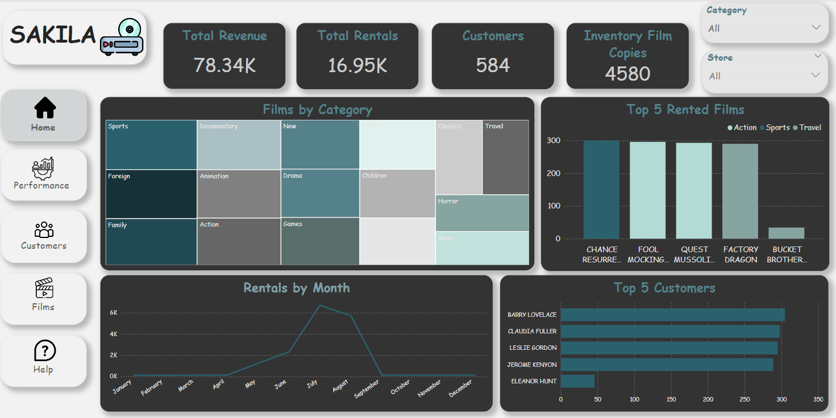
7.3 Utilizing PowerBI (Cont.)
7.3.1 Home Page Visuals Breakdown (Cont).

Slide 35
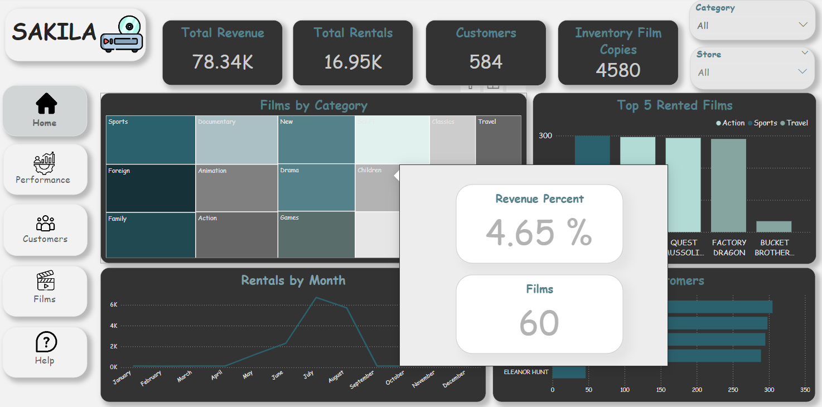
7.3 Utilizing PowerBI (Cont.)
7.3.1 Home Page Visuals Breakdown (Cont.)

Slide 36
7.3 Utilizing PowerBI (Cont.)
7.3.2 Performance Page Visuals Breakdown
Key Metrics: Cards for total rentals, film copies, revenue, number of films, and average rental duration.
Charts: Visuals for revenue over time, returns by film title, revenue by store, and return timing (late vs. on-time).
Slicers: Filters for film categories and stores.
Drill-Ups/Downs: Drill functionality between date, month and year (date hierarchy)
Navigation: Buttons for easy access to other pages.
The next page includes a screenshot of the dashboard layout.

Slide 37
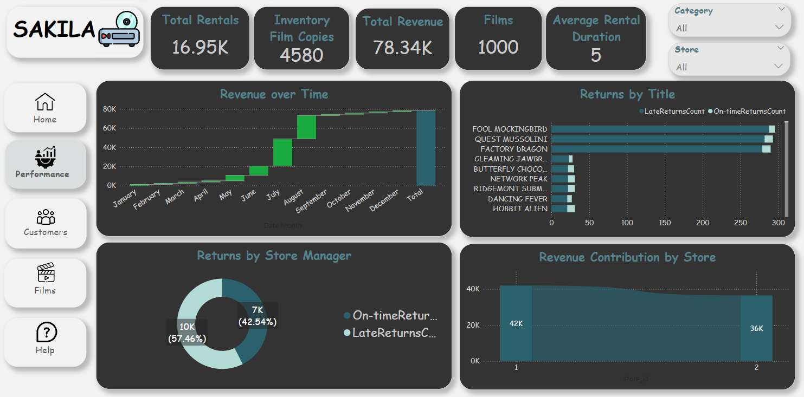
7.3 Utilizing PowerBI (Cont.)
7.3.2 Performance Page Visuals Breakdown (Cont.)

Slide 38
7.3 Utilizing PowerBI (Cont.)
7.3.3 Customers Page Visuals Breakdown
Key Metrics: Cards for total revenue, late returns, and on-time returns.
Charts: Visuals for revenue and rentals by customer, a map for customer locations, and a customer status filter (active/inactive).
Slicers: Filters for film categories, stores, and months.
Drill-Ups/Downs: Drill functionality between city and country.
Drill-Throughs: Interactive drill-throughs on customer name, leading to rental details table.
Navigation: Buttons for easy access to other pages.
The next page includes a screenshot of the dashboard layout.

Slide 39
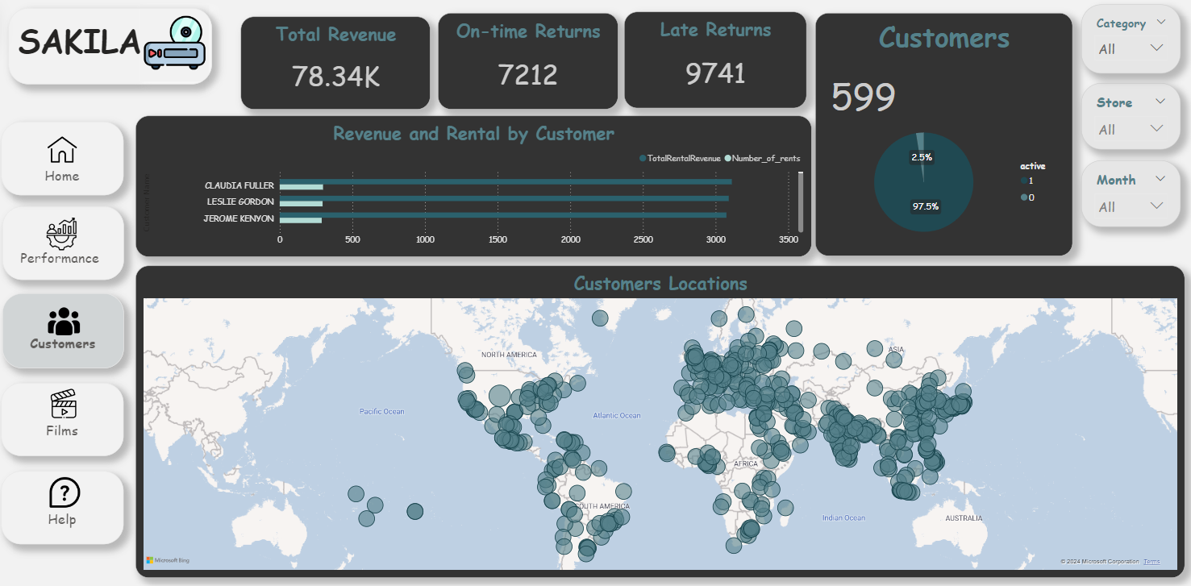
7.3 Utilizing PowerBI (Cont.)
7.3.3 Customers Page Visuals Breakdown (Cont.)

Slide 40
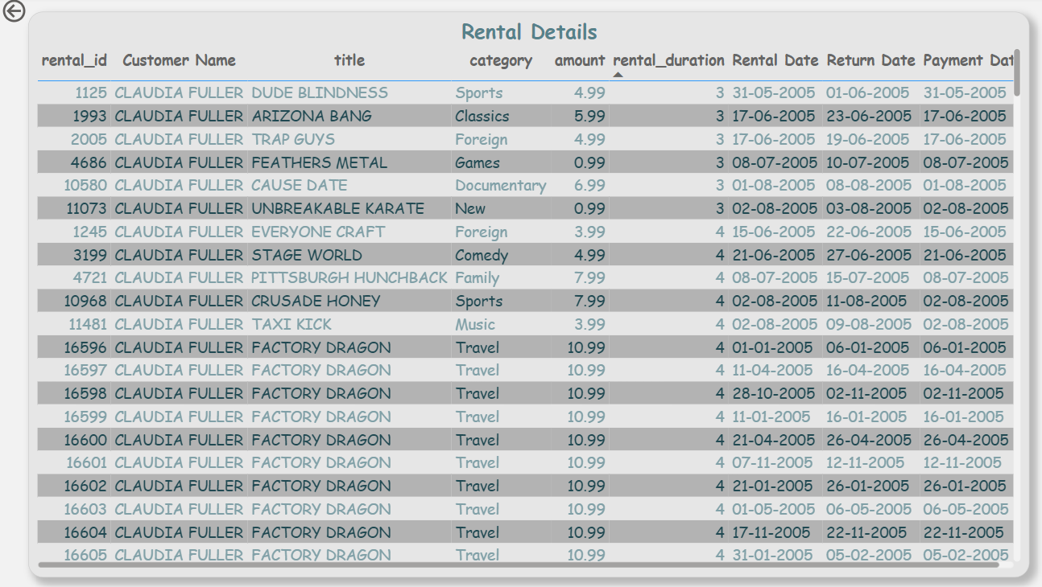
7.3 Utilizing PowerBI (Cont.)
7.3.3 Customers Page Visuals Breakdown (Cont.)

Slide 41
7.3 Utilizing PowerBI (Cont.)
7.3.4 Film Page Visuals Breakdown
Key Metrics: Cards for average film length, total films, and total rented films.
Charts: Visuals for top 10 actors by film count, films by rating, and film category contribution to revenue.
Slicers: Filters for film categories, special features, and length.
Drill-Ups/Downs: Drill functionality between film name and film category.
Drill-Through: Drill-through from film category and actor name to a detailed film performance table showing all rentals under that category or by that actor.
Navigation: Buttons for easy access to other pages.
The next page includes a screenshot of the dashboard layout.

Slide 42
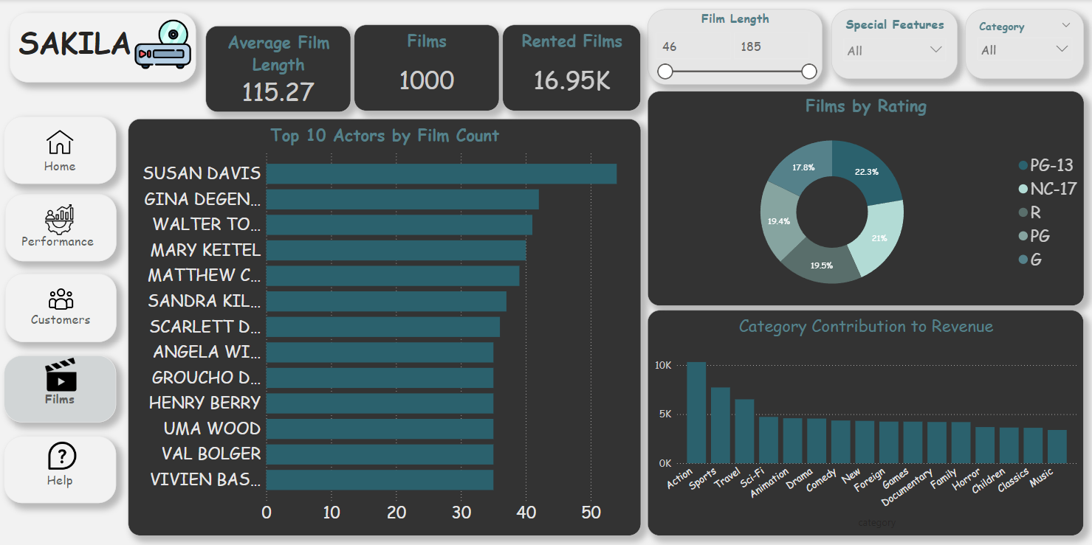
7.3 Utilizing PowerBI (Cont.)
7.3.4 Film Page Visuals Breakdown (Cont.)

Slide 43
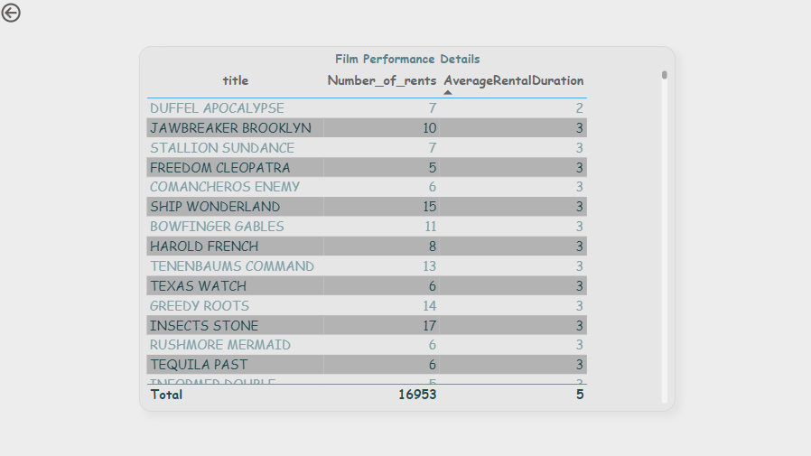
7.3 Utilizing PowerBI (Cont.)
7.3.4 Film Page Visuals Breakdown (Cont.)

Slide 44
7.3 Utilizing PowerBI (Cont.)
7.3.5 Help Page Visuals Breakdown
Navigation: Buttons for easy access to other pages.
Slicers: Filters for film title.
Details Table: Shows category, rating, rental rate and replacement cost for each movie.
Q&A Feature: Allows viewers to search for specific information within the dashboard.
Survey Link: Provides customers with a survey to help improve our business plan and refine movie selections for the next year.
The next page includes a screenshot of the dashboard layout.

Slide 45
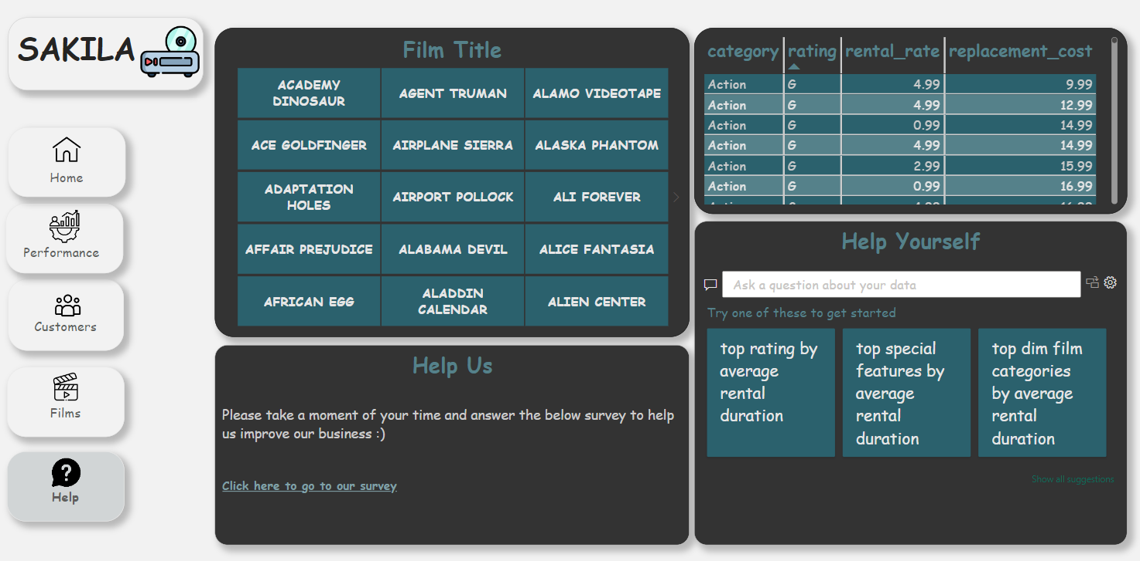
7.3 Utilizing PowerBI (Cont.)
7.3.5 Help Page Visuals Breakdown (Cont.)

Slide 46
7.4 Utilizing Tableau
In this section, We import data warehouse sakila_DWH from SQL Server and conducting comprehensive analysis.We create connection in data source and loaded the tables and Relation between them.And create sheets to cards Revenue and total customer and sheets to create charts to show main insight in sakila Revenue,rental details with customer ,copies inventory available in store DVD ,Actors and films category

Slide 47
7.4 Utilizing Tableau
7.4.1 Film Page Visuals Breakdown (Cont.)
Overview: The dashboard includes 4 charts, and 6 card
Key Metrics: Cards for Total Film, Total Actor, Total Customer, Language, Release Year, and Number of rent.
Charts: Total film by rental date, Top film by revenue and cost, total film by country in each category, top film by length.
The next page includes a screenshot of the dashboard layout.

Slide 48
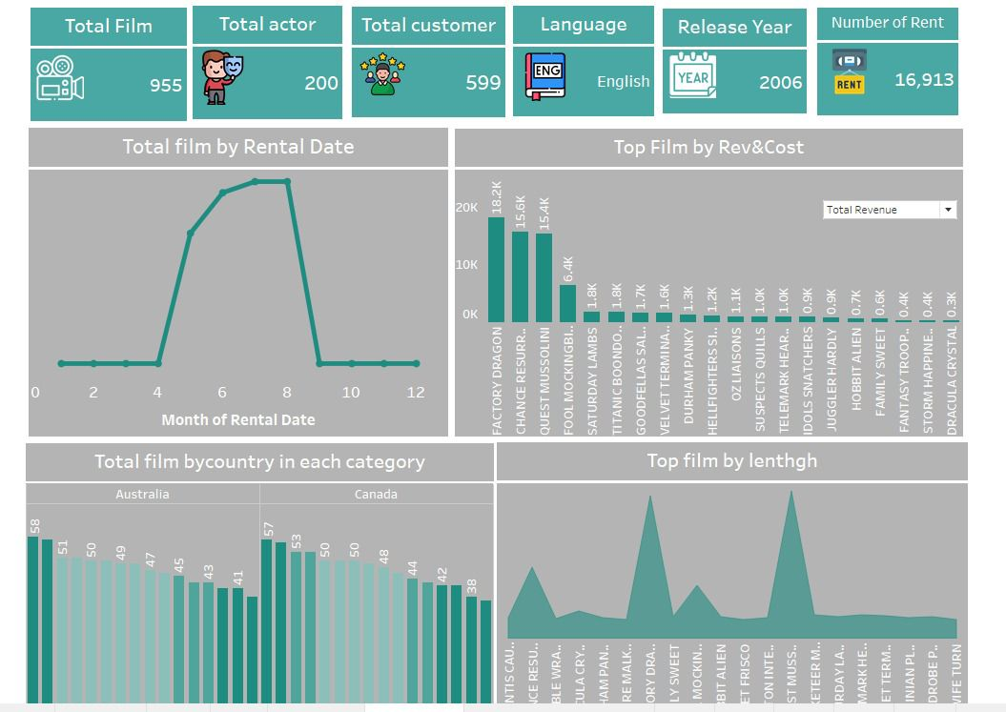
7.4 Utilizing Tableau
7.4.1 Film Page Visuals Breakdown (Cont.)

Slide 49
7.4.2 Utilizing Tableau
Overview: The dashboard includes 4 charts, 1 donut chart, and 4 card
Key Metrics: Cards for Total Revenue, Total Actor, Total Film, Total Customer.
Charts: The first chart represents forecasting for rental amount by months, second chart Total film by Top actor, third chart Total Rental amount by each category and forth chart Tree map represent Total film by category.
The next page includes a screenshot of the dashboard layout.

Slide 50
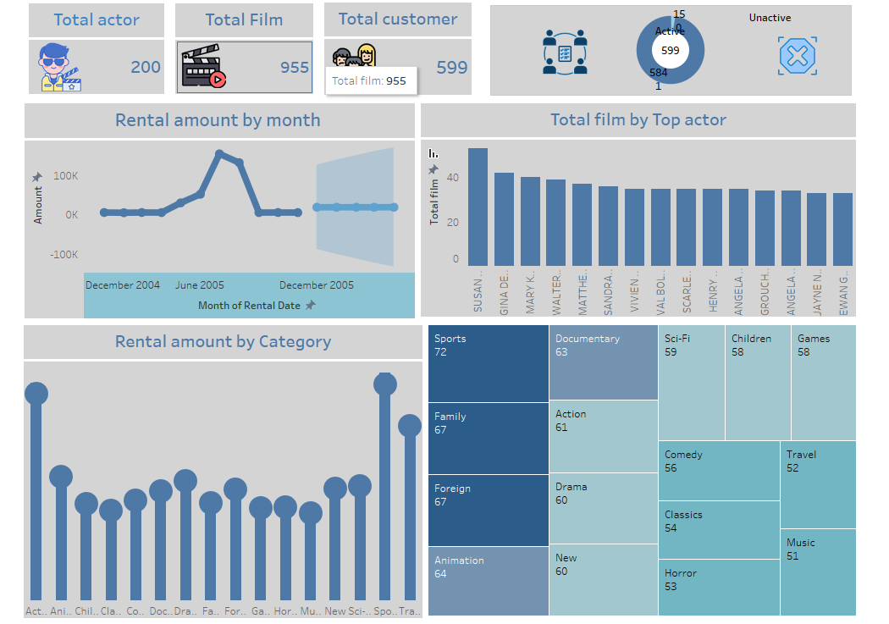
7.4.2 Utilizing Tableau (Cont.)

Slide 51
7.4 Utilizing Tableau (Cont.)
7.4.3 Revenues and rents Page Visuals Breakdown
Overview: The dashboard includes 4 charts, 2 filters, and 3 card
Charts: the horizontal bar represents the customer ID and we classified them in to high spenders and low spenders. The line chart represents the rentals per month.
Map: it includes the customer’s first and last name and total paid amount for all rents.
Filters: 2 filters for category and film name that affects the cards below to show its description, rating, and release year.
The next page includes a screenshot of the dashboard layout.

Slide 52
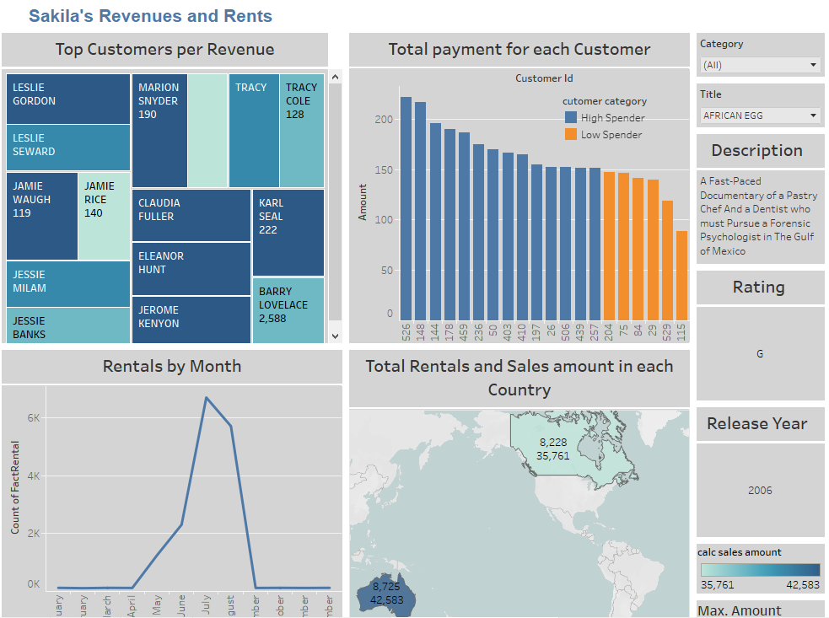
7.4 Utilizing Tableau (Cont.)
7.4.3 Revenues and rents Breakdown

Slide 53
7.4 Utilizing Tableau (Cont.)
7.4.4 Films, Types, and customers.
Overview : The dashboard includes 3 tables, 2 bar charts and 1 map
Tables: The first table represents the total replacement cost of all films in each category, then the second showed the number of films in each category and the top rented categories by the count of customer’s id.
Charts: The first bar chart represents the distribution of ratings by each category by showing the number of each rating in each category, as I differentiated between the ratings by different colors. The other chart shows the number of actors in each film by putting the film id in X-axis and the count of actor id in the Y-axis. The last thing is the Customers locations map that shows the country, city, count of customer’s id. The light color represents the small count, and the dark one represents the large count.
The next page includes a screenshot of the dashboard layout.

Slide 54
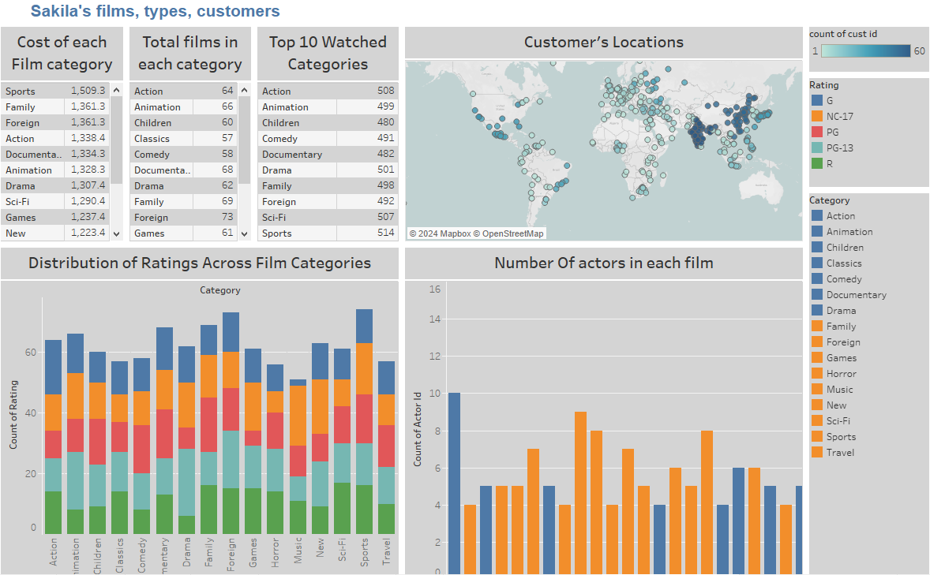
7.4 Utilizing Tableau (Cont.)
7.4.4 Films, Types, and customers.

Slide 55
7.4 Utilizing Tableau (Cont.)
7.4.5 Top Actors, Stores, and customers.
Overview: The dashboard includes 3 bar charts, 1 pie chart, and a tree map.
Charts: The first bar chart shows the film’s name and its total minutes. The second bar chart shows the top 3 actors that acts in many films. The last bar chart shows the available films in each store, and I showed the address of each store. Finally, the pie chart shows the top 3 customers who rented the film for the longest period by showing the number of days.
Tree map: it shows the customer’s name the total cost they paid as a replacement.
The next page includes a screenshot of the dashboard layout.

Slide 56
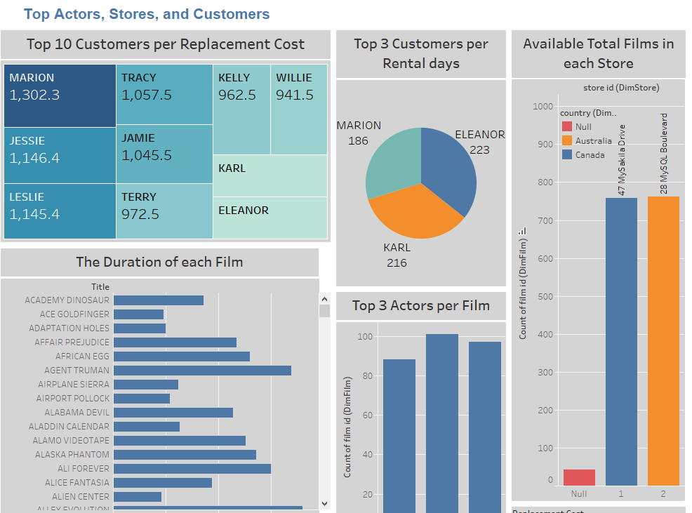
7.4.5 Utilizing Tableau (Cont.)
7.4.5 Top Actors, Stores, and customers.

Slide 57
7.5 Utilizing Microsoft Excel
We developed this detailed dashboard using Excel Power Query, importing data from SQL Server and conducting comprehensive analysis. To link the tables effectively, we used Excel's Data Model and Pivot Tables. The dashboard components include:
Key Metrics: Cards for total rentals, revenue, number of films, total customers and film copies.
Charts: Visuals for revenue & rentals over category, rentals by rating, revenue by month, top 10 countries by revenue & rentals and top 10 customers by rentals.
Slicers: Filters for rating, date and stores.

Slide 58
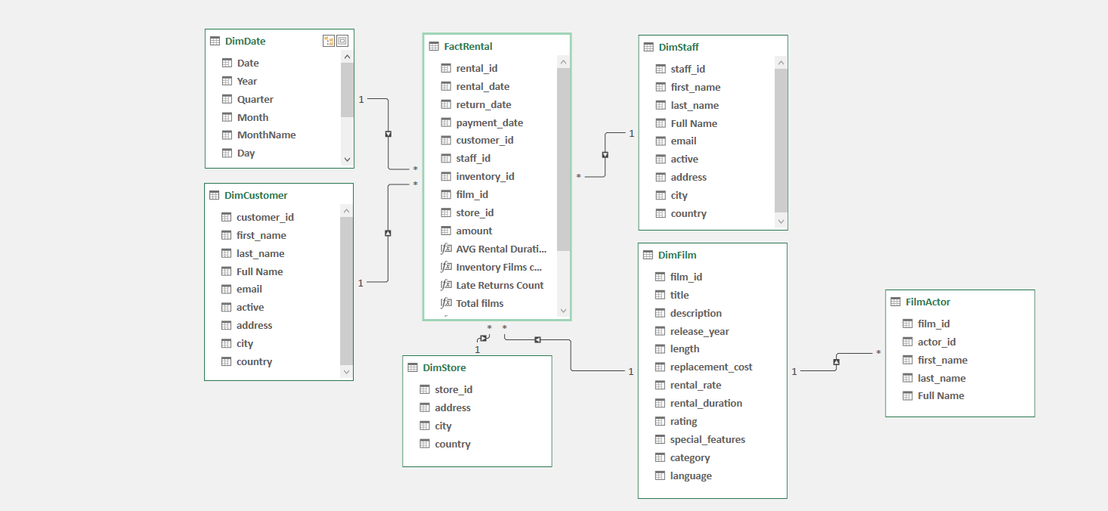
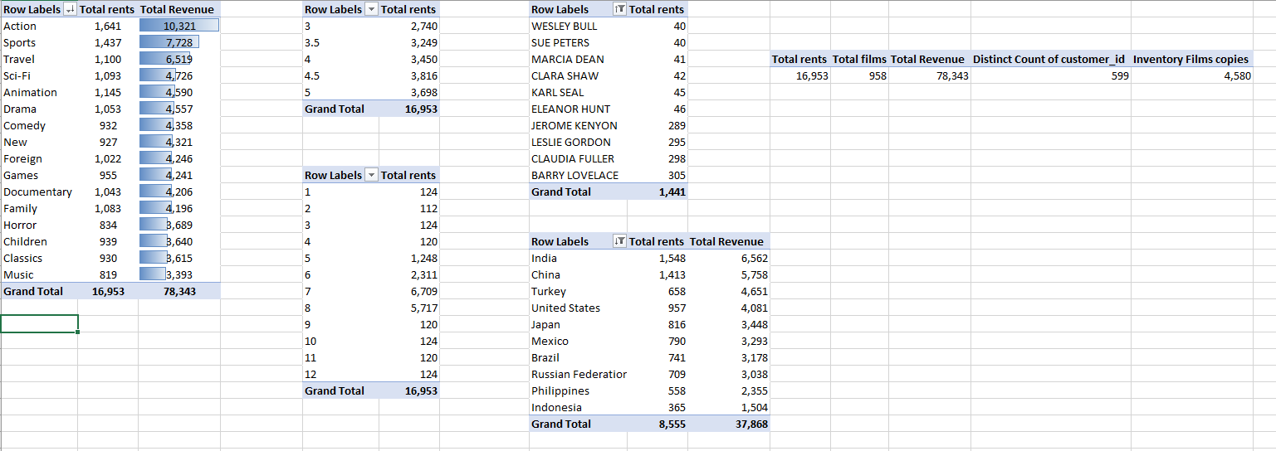
7.5 Utilizing Microsoft Excel (Cont.)

Slide 59
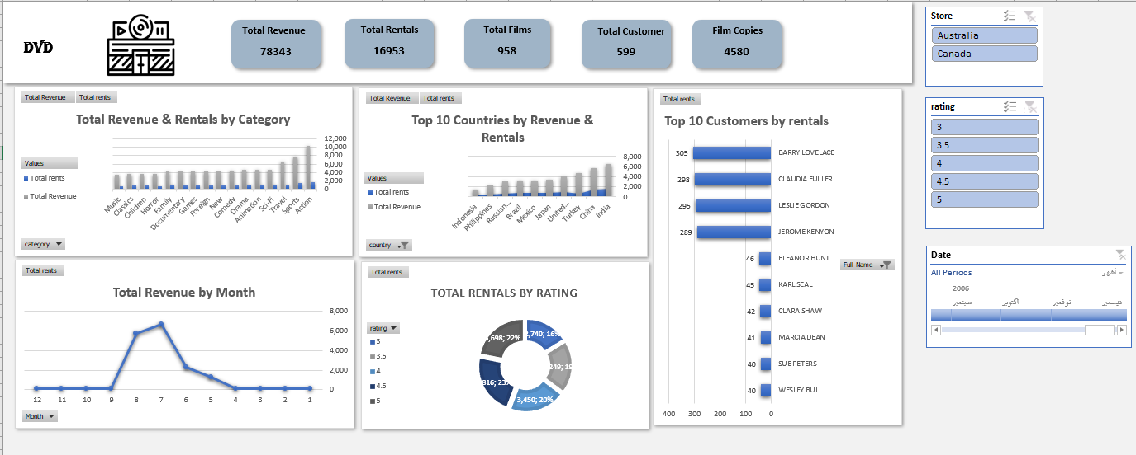
7.5 Utilizing Microsoft Excel (Cont.)

Slide 60

The Team
Israa Khaled
Fatma Alhussein
Marina Ashraf
Rodyna Elshemy
Sayed Mohamed

Slide 61
Thank You

